Slide 1
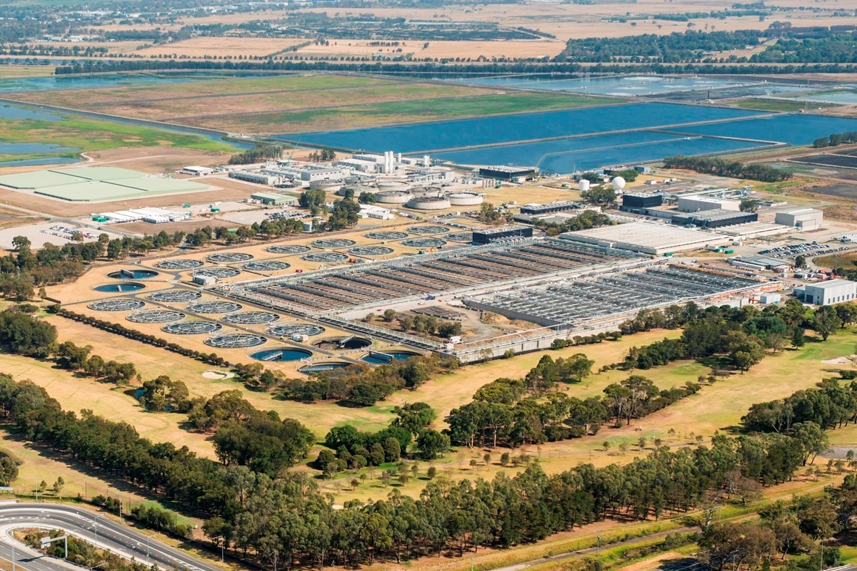
Architecture Presentation
WTP Birdwatching App
Date: November 2025
Author | Gary Franks | Document Classification | Official Sensitive
Sponsoring EA | GF | Submission Sponsor | Alistair McIntosh (Project manager)

Slide 2
Executive Summary
Architecture Advice
Request for TDA
The Western Treatment Plant (WTP) is a significant site of wetland habitat for over 300 species of birds and is a listed Ramsar wetland of international importance.
Members of the public can apply for a permit to visit the WTP for birdwatching. This provides them with access (physical keys) to the location for the purpose of birdwatching.
Birdwatching permit applications are made via a Pega Form on the public Melbourne Water website. Site operators then send out physical keys to approved permit holders, and conduct site orientations.
The WTP site is very large, with numerous hazards and the safety of those onsite is an ongoing concern for MW operational staff.
Currently site operational staff have minimal visibility of site entry and access and who is onsite at any given time. This presents challenges to notify birdwatchers in the event of heightened risk or need to evacuate the site.
A mobile app has been developed as a proof-concept to improve the experience for approved birdwatchers visiting the site. The app provides a digital guided tour, as well as capability for site operators to send real-time push notifications of hazards and site closures. The app also provides capability to integrate with Bluetooth locks and remove the need for distributing physical keys.
Assist
TBD
Endorse
The following architecture lifecycle positions for existing enterprise systems
System | Lifecycle
 | Current | Target
WTP Birdwatching App | Innovate | Invest

Slide 3
Strategic Context
Initiative Context
The WTP Birdwatching mobile app was developed as an initial Proof of Concept (POC) but not fully tested. The project will undertake further development and testing of the POC
The back-end platform is hosted in MW Azure tenancy
Front end client apps have been developed for Apple and Android devices
There is a web based front-end dashboard for use by system administrators
The detailed design has a small number of issues that don’t meet our cyber security requirements and is being reviewed and updated.
Architecture Context
Business Processes Architecture
Promote Organisation
Deliver Customer Service
Information Architecture
Location Information – Geography, Site
Risk – Hazard, Security
Customer & Community – Permit, Interaction, Customer
Application Reference Model
Customer:
Customer Service Management
Community Engagement
Asset Management
Site Security
Initiative Status: Idea/BNI/BCA stage
RFP responses from IBM, Microsoft, and Pega have been received, presented, and reviewed.
Support tier: Tier 4

Slide 4
Strategic Context (multiple, 2 slides ideal)
This project strongly aligns with our Digital Goals for Digital Customer and Digital Utility.
The project is forecast and costed on our Customer systems roadmap (Innovation)
Data-driven
Digital Customer
Stable & Secure
Digital Workforce
Digital Utility
Melbourne Water and our customers have easy access to timely and accurate data and insights to enable data-driven decisions to optimise outcomes
Customers & community engage, interact, transact
and collaborate with us online through responsive
and easy-to-use digital channels
An intelligent network of built and natural assets leveraging digital engineering, remote sensing, advanced analytics and automation enables Melbourne Water to move towards fully integrated water management
An integrated suite of fit-for-purpose and intuitive digital tools enables Melbourne Water’s workforce to be highly productive and engaged, regardless of location
The reliable delivery of services is supported by a stable, secure and financially sustainable portfolio of systems and infrastructure
Well structured, integrated & available data
Open & Inclusive
Analysis focussed on building insights
Trustworthy data quality
Compliant and secure
Water literacy & citizen science
Customer digital services
Customer experience
Understanding our clients
Enriched customer digital services
Risk management
Service quality
Support quality
Cyber security
Financial sustainability
Teamwork and collaboration
Mobility
Digital maturity & capacity
Training
User experience
Predictive asset management
Future focussed
Smart service planning
Smart asset simulation
Service & operational performance visualisation
Safety

Slide 5
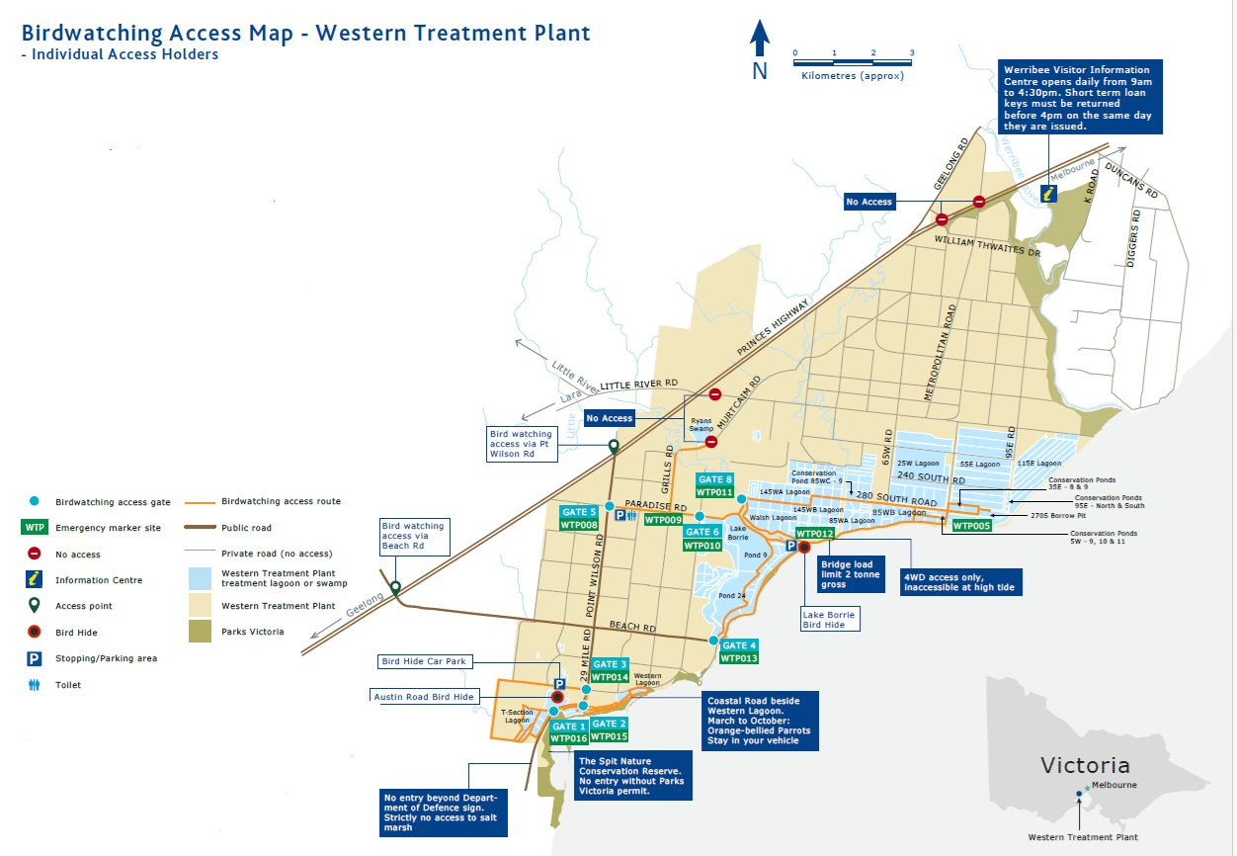
WTP birdwatching location
Birdwatching areas

Slide 6
Functional use case
Existing system
Infrastructure component
Data Flow (integration)
System with issues
Data Flow (Manual)
Birdwatching application form
Birdwatching application form is not in scope for this paper
Apply for birdwatching permit
Approve & manage permits
Customer team
Pay for permit (access and key)
Report on payments
WTP Birdwatching app
Finance team
Access safety induction orientation information
Birdwatcher
Access information about the site
Plan a trip to WTP
Bluetooth Beacons (placed at gates)
Navigate across the WTP birdwatching site
Integrate with Bluetooth beacons
Report issues onsite (eg hazards, dead birds)
Bluetooth lock system
BACID
WTP Operator
Open Bluetooth enabled locks to access site
Integrate with Bluetooth lock system
Manage access to site Bluetooth locks
Receive reports about who is on-site
Send messages / alerts to users
System administrator
Administer system

Slide 7
Target State – Systems landscape
Existing system
Infrastructure component
Data Flow (integration)
New integration
System with issues
New / changed system
Data Flow (Manual)
Melbourne Water internal network
DMZ
Internet
BACID
Smartphone
WTP Birdwatching App
Bird noticer
Mobile app (Android and IOS versions)
bluetooth gate lock
Web Proxy
Gallagher mobile app
Gallagher app to allow use of bluetooth locks
Site operator
Session
Note Azure edge security doesn’t exist yet
Azure edge security
MW Azure tenancy
MW Laptop
Edge browser
apim
Back-end application
WTP Birdwatching app backend
Web App
API
MW users are authenticated by Entra ID
MySQL
Birdwatching database
Public birdwatcher users are authenticated against user accounts in SQL table
Application data
Entra ID (Authentication)
User auth DB

Slide 8
Target State – Systems landscape Alternative network path
Existing system
Infrastructure component
Data Flow (integration)
New integration
System with issues
New / changed system
Data Flow (Manual)
Melbourne Water internal network
DMZ
Internet
BACID
Smartphone
WTP Birdwatching App
Bird noticer
Mobile app (Android and IOS versions)
Web Proxy
bluetooth gate lock
Gallagher mobile app
Gallagher app to allow use of bluetooth locks
MW Laptop
Edge browser
Session
Note Azure edge security doesn’t exist yet
MW Azure tenancy
Site operator
apim
Back-end application
WTP Birdwatching app backend
Web App
API
MySQL
Birdwatching database
Public birdwatcher users are authenticated against user accounts in SQL table
Application data
MW users are authenticated by Entra ID
Entra ID (Authentication)
User auth DB

Slide 9
Key Decision 1:
Description | WTP Birdwatching app – conceptual design
Scope | Hosting environment
Options considered | Option 1: MW Azure tenancy Option 2: Other, separate environment
Recommended option | Option 1: MW Azure tenancy
Justification | Strategic Alignment | Alignment with current cloud hosting strategy
 | Solution Risk | Moderate risk – proposed system will have external facing APIs
 | Functional Fit | Proposed solution meets business functional needs
 | Total Cost of Ownership | Ongoing management of the system will be required. It is proposed to utilise our internal development team for this.
Trade-offs | The proposed solution will use an internal database based authentication for public users. While the strategic option would be to integrate with Dynamics and use Entra ID B2C, this isn’t feasible at this time (Recommend re-visiting in 2 years time)

Slide 10
Key Decision 1: Principles Alignment
Architecture principles | Alignment | Rationale and business Implications
Maximise the benefit to the Enterprise | Full | Will provide improved customer experience for public stakeholders
Deliver with early and continuous engagement of stakeholders | Full | Solution has been developed with business stakeholders
Simplify and Standardise the architecture | Full | Will use standard mobile application software stack
Consider end-to-end service lifecycle and total cost of ownership in decisions | Full | Will leverage in-house mobile application capability
Care for information | Full | Solution detailed design will follow MW cyber security standards
Architect for adaptability | Full | 3-tier solution architecture (model, view, control) allows for ease of reconfiguration of the system in future if needed
Solutions are designed to be user-centred, accessible and usable. | Full | Will support and enable Melbourne Water’s accessibility & usability standards and requirements

Slide 11
Recommendation
Next Steps
The recommendation of this paper is to endorse re-development of the WTP birdwatching application to a production ready solution
Implications
Solution will be designed and built by our internal mobile apps team
It is noted the public user authentication will be based on a SQL mechanism. It is recommended to re-visit this in 2 years when the Dynamics CRM and Entra ID B2C capability is available
Note the solution would ideally use the Azure edge security layer for external presentation of APIs. This is still in development and won’t be available until after April 2026
Solution detailed design

Slide 12
Architecture risks
Note outcome risks / requirements from TIRA here:
Information:
Privacy:
Cyber security:

